Slide 1
ECE 544 Final Presentation
Android Controlled Car
Team Members:
Zhe Lu
Ram Bhattarai
Ming Ma

Slide 2
Project Description
For this project, we have designed an android controlled car. This car has 2 motors which are controlled by two PmodHB3 connected to Nexys A7 board. The control signals are given from two sources: Android App or Gestures. These control signals will be transferred to Nexys A7 board by using Firebase and NodeMCU32. The communications between NodeMCU32 and Nexys A7 are achieved using UART. Also, we have two distance sensors connected to Nexys A7 board. The car can’t move forward or backward if there is an obstacle within a range of 15 cm. Four LEDs are also connected to the FPGA. So, our car will turn on different LEDs accordingly based on different motions, just like the real car.

Slide 3
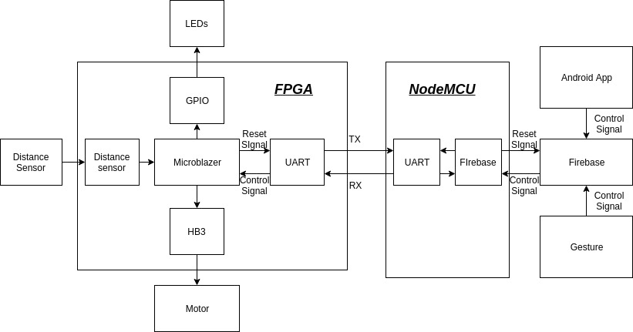
System Block Design

Slide 4
Achievements before and after Progress Demo
Before Progress Demo:
Assembled the car model
Tested distance sensor code
Tested NodeMCU wifi module
Tested controlled of the two motors
Tested UART communication.
After Progress Demo:
Software control code for the car
Integrate NodeMCU wifi module with Nexys A7 board and firebase
Integrate distance sensor with Nexys A7 board
Play alert if there is an obstacle in the range of 15 cm(front and back).
Draw a 3D model for our car.
Turn on different LEDs based on different motions.
Use Android app to control our car.
Use Gestures to control our car.

Slide 5
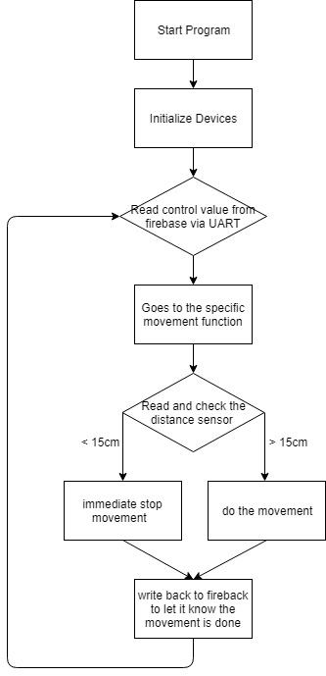
Software Controller.
Software controls movement of the car
Listen control signals from firebase, distance from distance sensor
Send control signal for movement to car

Slide 6
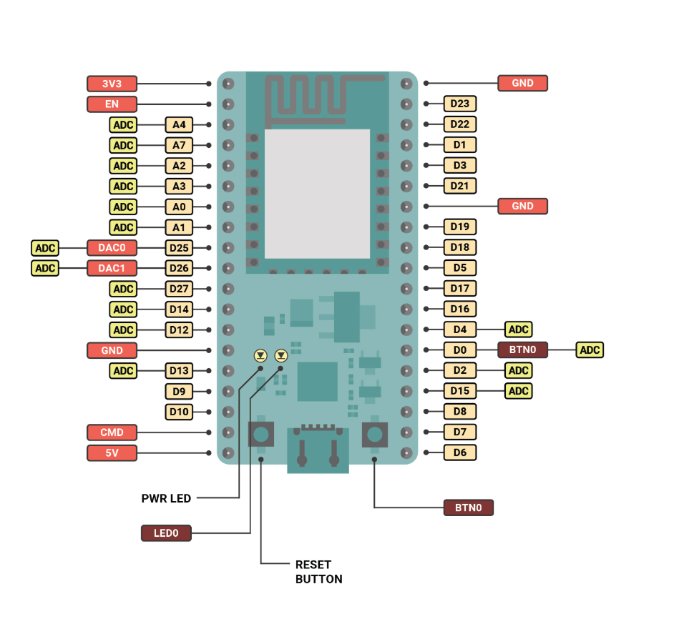
NodeMCU with Nexys A7 and firebase
NODEMCU ESP32 WIfi module sets up wifi
Programmed with Arduino IDE
Listens to update from firebase and Uart
Sends the Firebase update to Nexsys A7 using Uart
Receives signal from Nexsys A7 indicating that car is stopped

Slide 7




Gesture Control
Fist
Palm
Swing
Peace
Steps Achieving Gesture Recognition
Image Generation
Training: 1000 Images
Validation: 100 Images
Image Resizing
Resize the image to smaller size for better results.
Labeling the image
Labeling what each gestures means
1: Fist, 2: Palm, 3: Swing, 4: Peace
→
FWD
Reverse
LEFT
Right
Training: Neural Network(TensorFlow)
CNN: Convolutional Neural Network
7 Layers, 1 Fully Connected Layer
Testing
Tested with 100 images for each
Accuracy: 95 Percent
Training and Prediction in Python

Slide 8
Android App Control
Option Activity:
Provides two modes for the game:
Control with Phone
Control with Gesture
4 Activities
Splash Screen(App starts with animating car)
Option Activity(Option for Gesture or Phone control)
Phone Activity(Handles the UP, DOWN, LEFT, Right) Arrow presses
Gesture Activity(Handles all the Gesture activity)
Gesture Activity:
Listens to the update from firebase and updates the textview with current gesture
Phone Activity:
Listens to the Arrow press and updates the firebase with control signal.

Slide 9




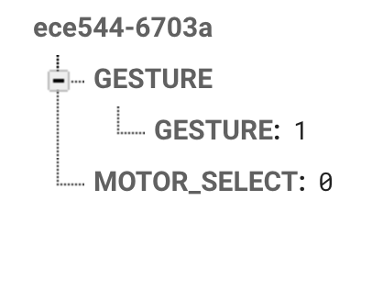
Android APP and Firebase
Each of these Arrow press, updates the control signal on firebase
When Gestures is available, it is updated in firebase
All the gestures and arrows are encoded to 1(FWD), 2(Reverse), 3(LEFT), 4(Right)

Slide 10

Integrate Distance Sensor and Alert.
The distance sensor is not working properly when we integrate this with FPGA. The measured distance is not accurate and is not stable. Then, we found we use 100 Mhz clock which is too high. The distance sensor works good after we use 10 Mhz.
For the alert sound, we just find a alert sound which is in format of .wav. Then, we convert this sound to .ceo file and store this into BRAMs of Nexys A7 board. Then we use the on-board amplifier to play this sound when an obstacle is in range of 15 cm.
AUD_PWM: used to play the sound
AUD_SD: shutdown mode. Just give it to 1.

Slide 11
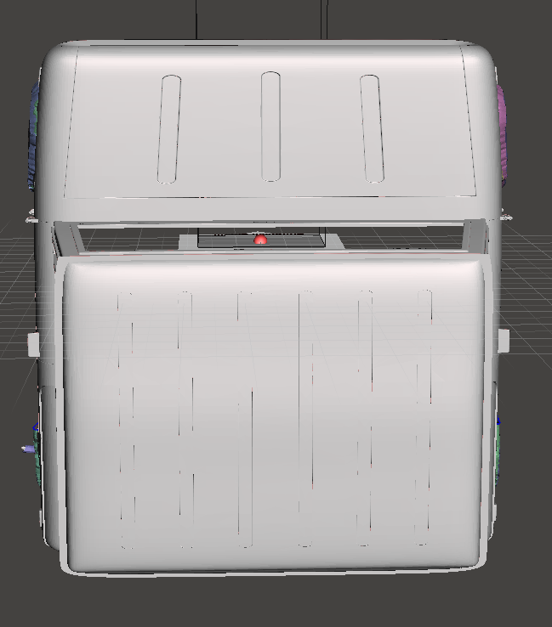
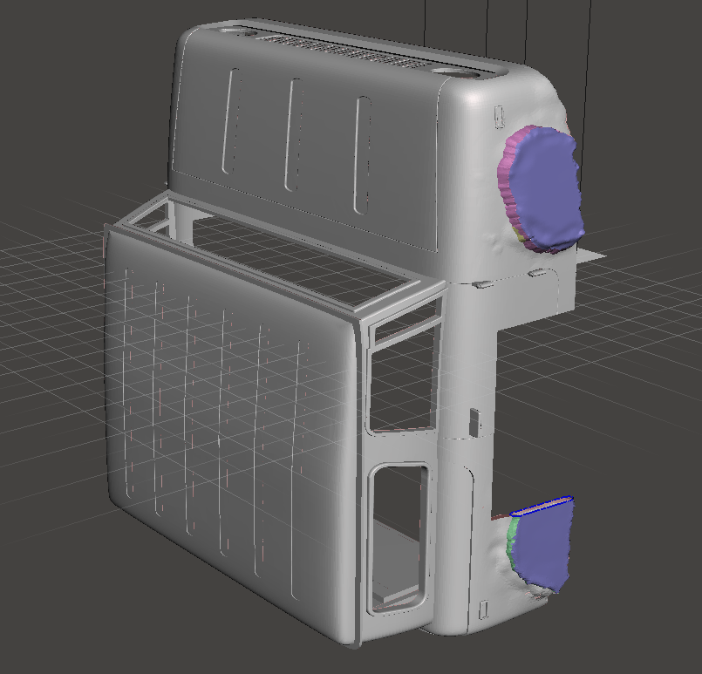
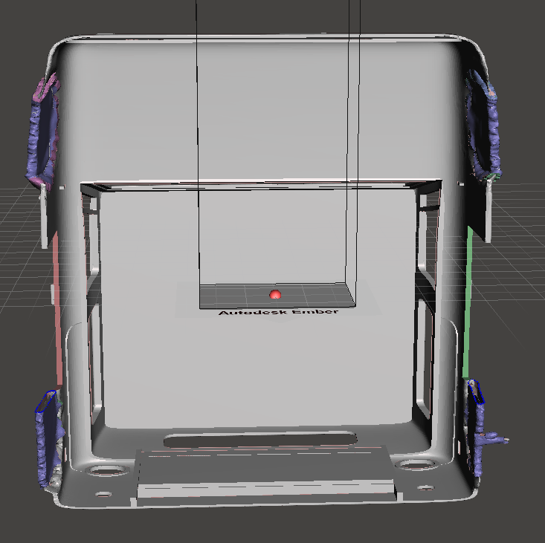
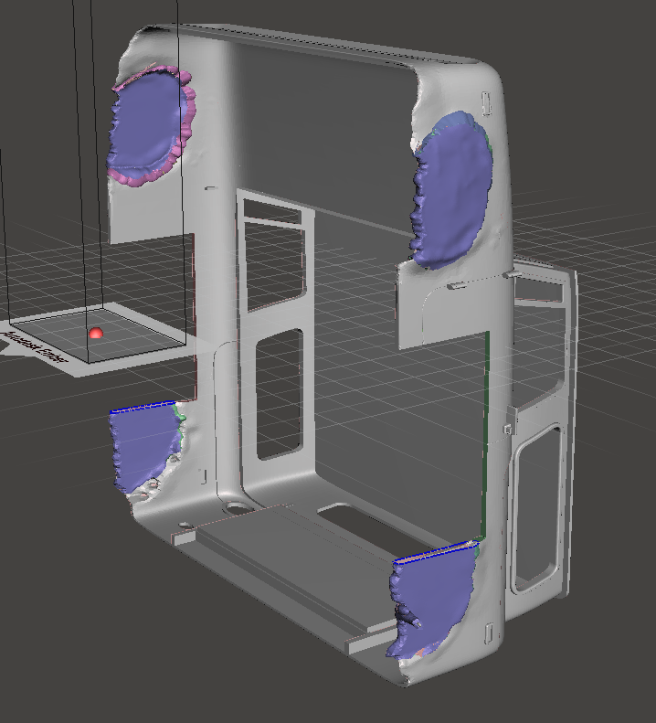
3D Model
Length: 230mm. Width: 230mm. Height: 110mm
The size of our 3D model is too big to print by using the printers in EPL and Library.
Also, it will cost about 42 hours to print our model. We also don’t have enough time.

Slide 12
Future Work
Use built-in camera from phone to recognize gestures.
Use 4-Wheel driven car model
Try to do the gestures recognition in FPGA.
Print our 3D model.

Slide 13
Demo

Slide 14
Thank You!

